Slide 1
GROUP NUMBER: 02
TITLE :
ELECTRIC FIELD CONCEPTS WITH APPLICATIONS LIKE PHOTOCOPIERS AND CAPACITIVE TOUCH SCREENS.
GROUP MEMBERS
ID | NAME
F24CSC019 | DANIYAL ALI
F24CSC009 | MOHSIN AHMED
F24BSE016 | HAFIZ ABDULLAH
F24CSC047 | DILAWAR ALI
F24CSC029 | MUHAMMAD SAAD ALI
F24CSC038 | SYED SAAD ALI

Slide 2
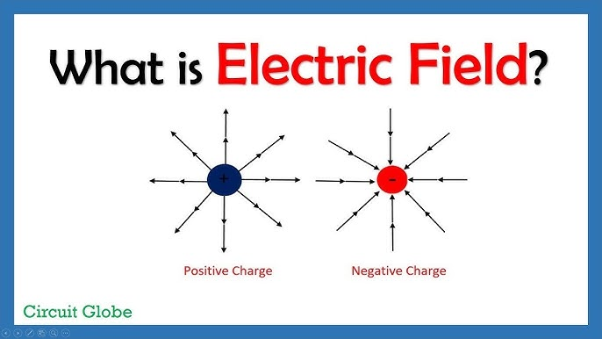
Introduction:
Electric fields are at the heart of how charged particles interact, shaping the forces between them. They’re not just a theoretical concept, they power much of the technology we use daily. From the smartphones in our hands to photocopiers and heavy machinery, understanding electric fields is essential for making these devices work smoothly.

Slide 3
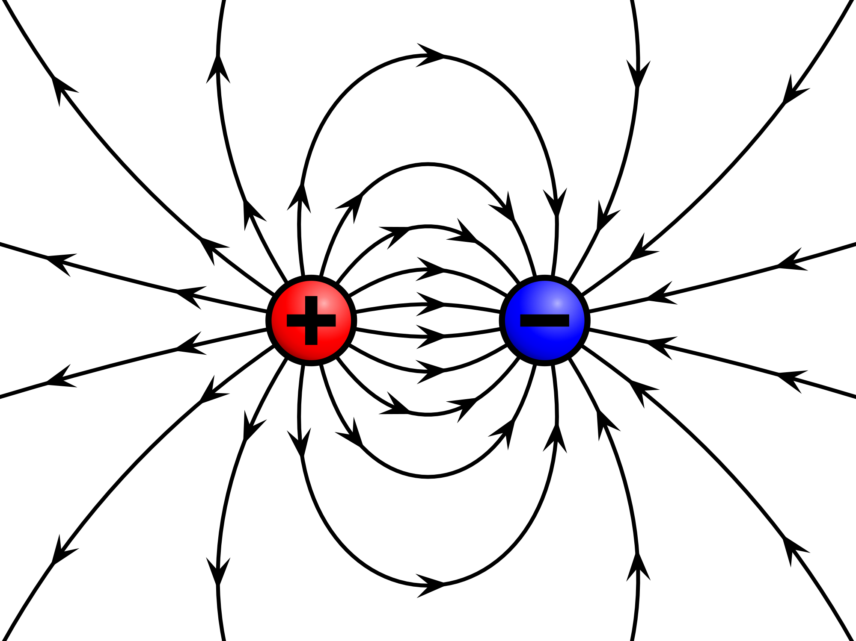
Importance of the Topic:
Electric fields are key in many technologies that we use daily. They enable the function of devices that range from printers to smartphones. By understanding how electric fields work in these contexts, we can improve and innovate on existing technologies, making them more efficient and versatile.
ELECTRIC FIELD LINES

Slide 4

Concept of Electric Field
An electric field is created by charged particles (either positive or negative) and is responsible for the force experienced by other charges placed within this field. The electric field (E) at a point is defined as the force per unit charge:
E=F/q​
Where F is the force experienced by a test charge q. The electric field is a vector field, meaning it has both magnitude and direction. The direction of the electric field points away from positive charges and toward negative charges. The field's strength depends on the magnitude of the charge and the distance from the charge, following Coulomb’s law:
E $=\frac{k . |Q|}{r^{2}}$
Where k is Coulomb's constant, Q is the source charge, and r is the distance from the charge.

Slide 5
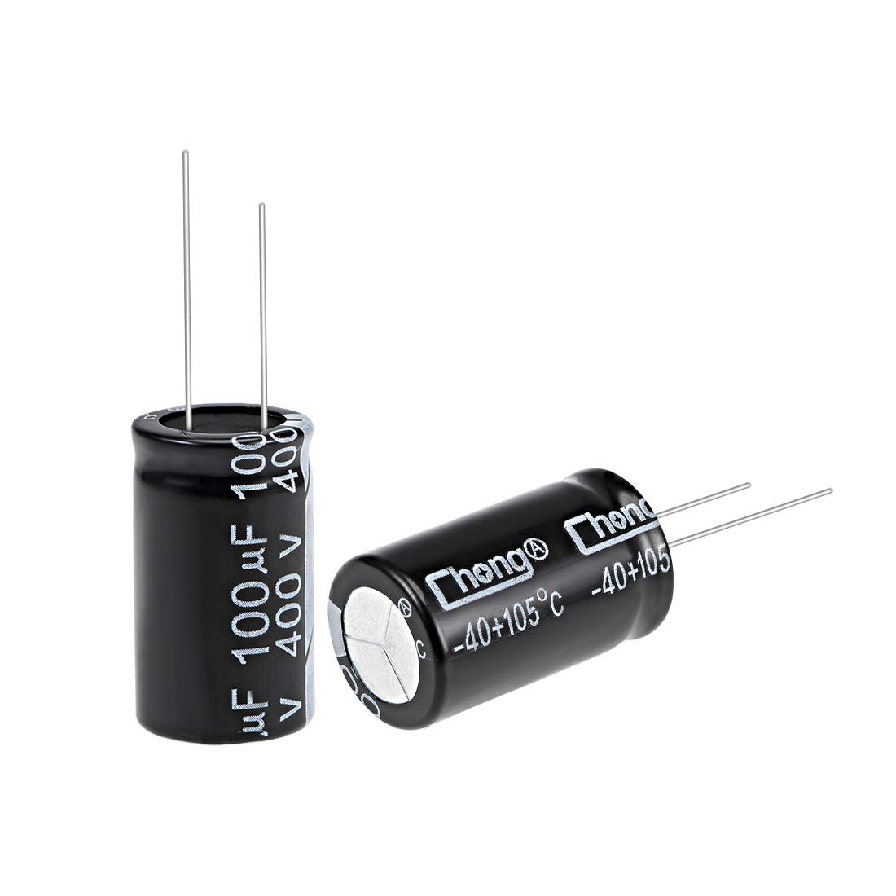
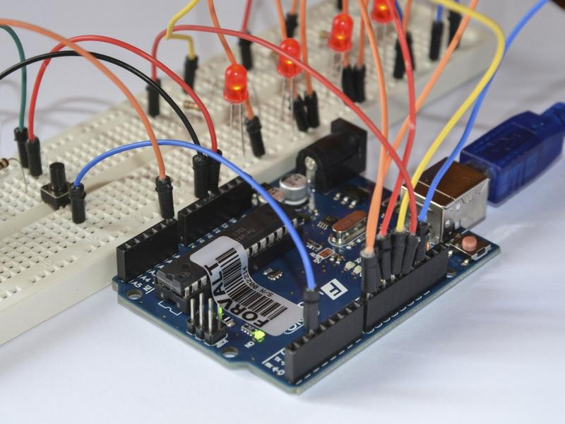
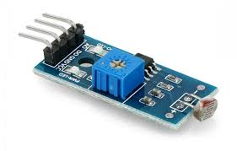
Applications of Electric Fields:
Capacitors: They store energy by creating a potential difference between two conductive plates separated by an insulating material.
Electronics: Electric fields help control the flow of current in devices like transistors and diodes.
Sensors: In devices like touchscreens, electric fields detect changes in capacitance to enable interaction.
Medical Equipment: Electric fields are used in medical imaging and treatments, including electrocardiograms (ECGs) and defibrillators.
By understanding electric fields, scientists and engineers can design and enhance a wide range of technologies, from everyday electronics to renewable energy systems.

Slide 6

Photocopiers
Photocopiers rely on electric fields in a process called electrophotography, which uses charges to transfer an image onto paper. Here's how it works:
Charging the Drum: A photoconductive drum is coated with a uniform charge by a high-voltage corona wire, creating an electric field on its surface.
Light Exposure: The document is scanned, and light removes the charge from exposed areas of the drum, while the darker areas retain their charge due to the electric field.

Slide 7
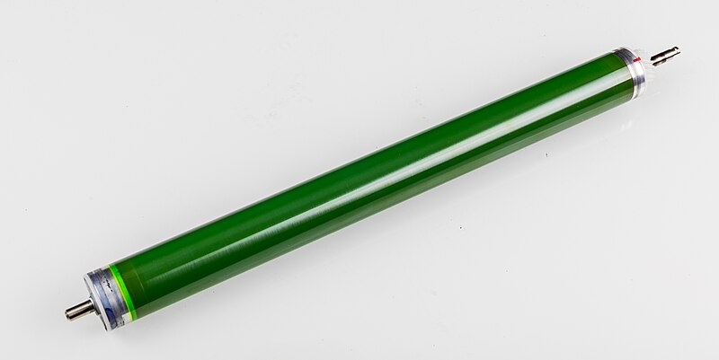
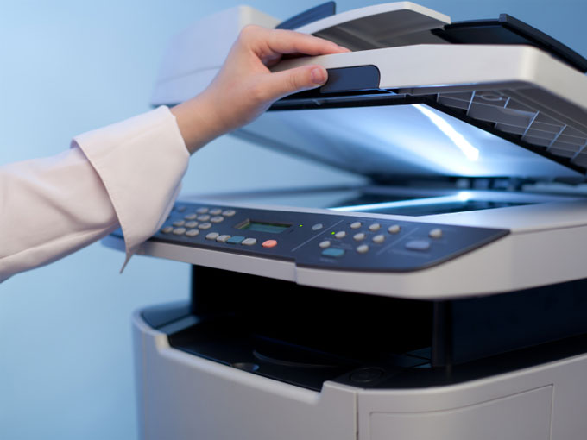
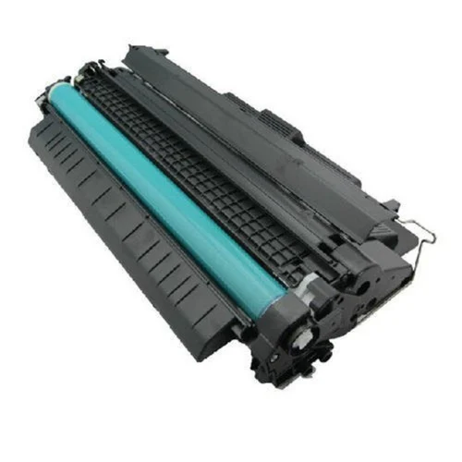
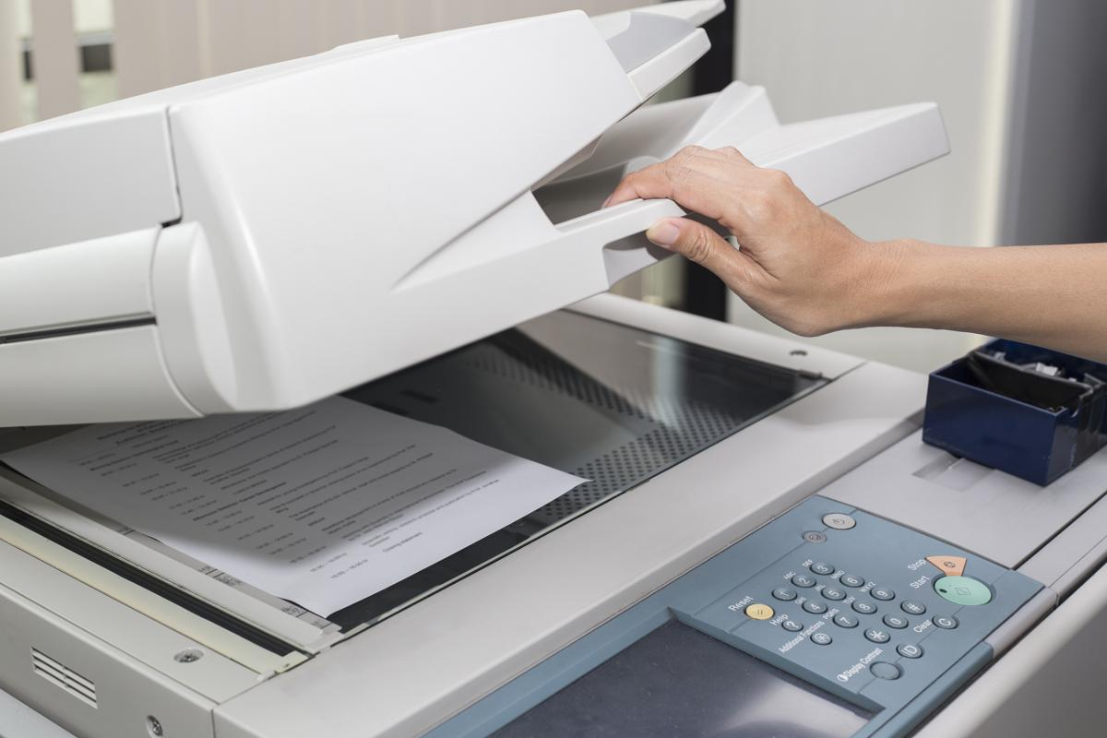
Toner Application: Negatively charged toner is applied to the drum. The toner sticks to the positively charged areas while avoiding the uncharged regions.
Transferring to Paper: The toner is transferred to the paper using electric fields, where it's held in place by electrostatic forces and then fused with heat to produce the final copy.
This process highlights how electric fields are used to control and move charged particles to create accurate copies of documents.
1. Photoconductive Drum
2. Light Exposure
3. Toner
4. Transferring to paper

Slide 8
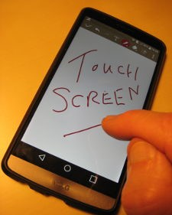
Capacitive Touchscreens
Capacitive touchscreens use electric fields to detect touch by taking advantage of the human body’s conductive properties. Here’s how they work:
Creating the Electric Field: The screen has a layer of transparent, conductive material, usually indium tin oxide, arranged in a grid of electrodes. These electrodes generate a uniform electric field across the screen.
Touch Detection: When a finger touches the screen, it disrupts the electric field at that point. Since the human body conducts electricity, it changes the capacitance in the area of contact.

Slide 9
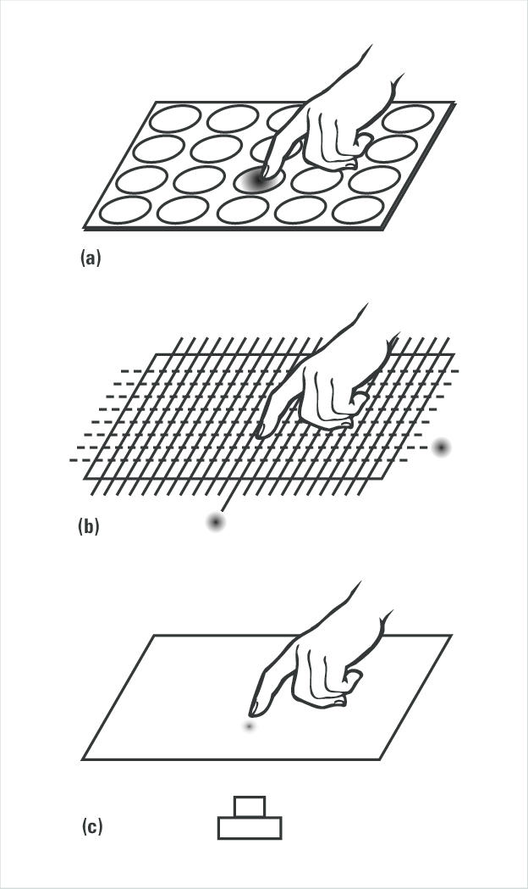
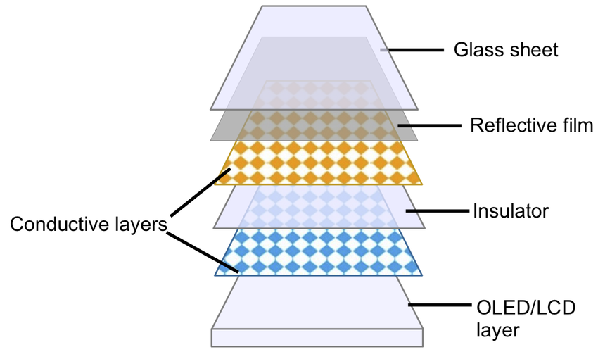
Locating the Touch: The touchscreen senses this change in capacitance and pinpoints the exact location of the touch based on the disturbance in the electric field.
Processing the Input: The device’s controller processes the information to interpret the user’s action.
Layers of touchscreen
Touch detecting process

Slide 10
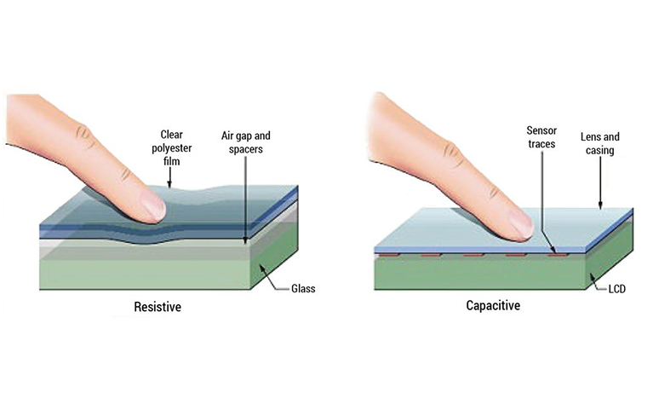
This technology is essential in devices like smartphones, tablets, and other touch-sensitive gadgets, where electric fields enable seamless user interaction.

Slide 11

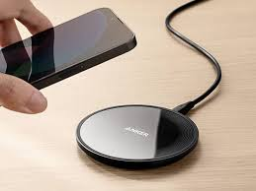
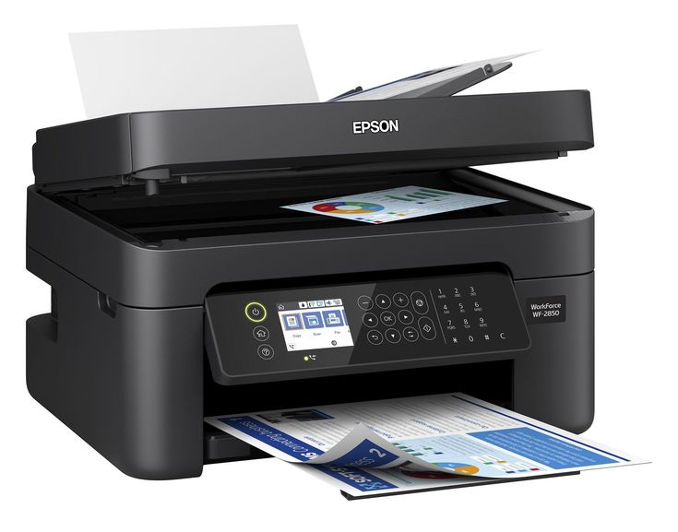

Real-Life Examples
Here are a few real life examples of where electric field is responsibe for
Lightning
Inkjet Printers
Laser Printers
Electric fencing
Dust attraction to TV screens
Wireless charging pads for smartphones and laptops
Liquid Crystal Displays (LCDs) in monitors and TVs

Slide 12
Conclusion:
Electric fields are fundamental to various technological applications, including photocopiers and capacitive touchscreens.
In photocopiers, electric fields are used to transfer toner particles onto paper, while capacitive touchscreens use electric fields to detect user input by measuring changes in capacitance.
These applications are critical in everyday devices such as printers and smartphones, demonstrating the importance of electric fields in modern technology. The understanding of electric fields not only helps in improving existing technologies but also opens the door for innovations in fields like electronics, communication, and computing.
References:
Griffiths, D. J. (2017). Introduction to Electrodynamics (4th ed.). Pearson Education.
"Capacitive Touchscreen Technology," TechRadar. Retrieved from https://www.techradar.com.
"How Photocopiers Work," HowStuffWorks. Retrieved from https://electronics.howstuffworks.com/photocopier.htm.

